Slide 1
Understanding:
Entrepreneurship

Slide 2
Definition of Entrepreneurship
An Entrepreneur : One who
Organizes,
Manages and
Assumes Risk of a Business or Enterprise

Slide 3
Entrepreneurship
Entrepreneurship is a mindset
  Opportunity-focused
  Innovative
  Growth-oriented

Slide 4
Some Modern Definitions
Scott Shane (Case Western) – “Entrepreneurship is an activity that involves the discovery, evaluation and exploitation of opportunities to introduce new goods and services, ways of organizing, markets, processes, and new materials through organizing efforts that previously had not existed.”
Howard Stevenson (Harvard) – “.. The pursuit of opportunity without regard to resources currently controlled.”
Gibb Dyer, Jr. – “The founding of new businesses is the essence of entrepreneurial activity.”

Slide 5
What is Entrepreneurship?
Cantillon (1700’s)
Say (1803)
Knight (1921)
Schumpeter (1934)
Kirzner (1973)
Gartner (1988)

Slide 6
Richard Cantillon (1697-1734)
The entrepreneur is a specialist in taking on risk
He “insures” workers by buying their products (or labor services) for resale before consumers have indicated how much they are willing to pay.

Slide 7
Frank Knight (1885-1972)
Entrepreneur has a two-fold function
  Exercising responsible control (directing the work of others)
  Securing the owners of productive services against uncertainty and fluctuations in their incomes
Distinguished between risk, which is insurable, and uncertainty, which is not
  Uncertainty includes things like changes affecting the marketing of consumer products (e.g., fashion trends)
Profit compensates entrepreneur for bearing uncertainty

Slide 8
Joseph Schumpeter (1883-1950)
(1934) - “implements change (‘creative destruction’) within markets through the carrying out of new combinations”.
(1942) – The entrepreneurial function “does not essentially consist in either inventing anything or otherwise creating the conditions which the enterprise exploits. It consists in getting things done.”
A lot of what an entrepreneur does on a day-to-day basis is not “entrepreneurial”

Slide 9
Israel Kirzner
Entrepreneur is an arbitrageur
He or she discovers previously unknown market opportunities
Key characteristic is entrepreneurial “alertness”

Slide 10
Synthesis of “Entrepreneurship”
In general, even entrepreneurship researchers can’t agree on what the “best” definition of entrepreneurship is
Two main camps
  Discovery, evaluation, and exploitation of opportunities
  Starting new businesses

Slide 11
Synthesis of “Entrepreneurship”
Previous economists do a nice job defining entrepreneurship
  Concerned with decisions surrounding new profit opportunities
  Concerned with assembling resources
  All in the midst of uncertainty
But they don’t address who is likely to be an entrepreneur, or even more important, a successful entrepreneur

Slide 12
The Promise of Entrepreneurship
An integrated input/output model
The career assessment approach
The new venture creation process

Slide 14
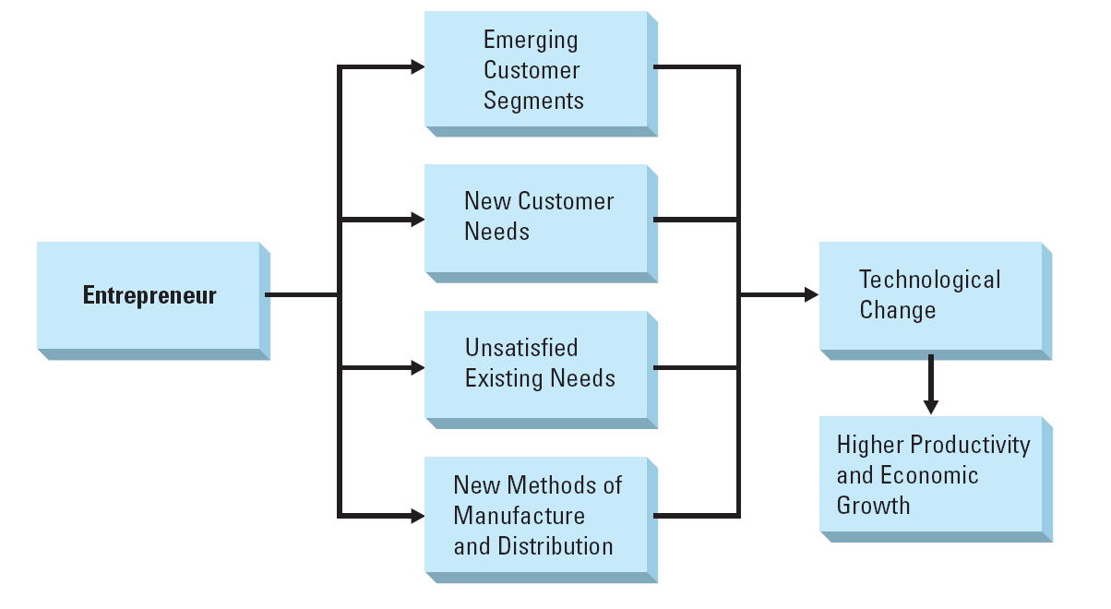
Entrepreneurship and Technological Change

Slide 15
Outcomes of Entrepreneurship
Economic growth
New industry formation
Job creation
> Knowledge, Wealth, Philanthropy <

Slide 16
The Nature of Entrepreneurial Start-ups
An entrepreneurial venture brings something to the marketplace.
Three primary characteristics
  Innovative
  Value-creating
  Growth-oriented

Slide 17
New Business Formation
Entrepreneurs use identifiable milestones to measure their progress:
  Deciding to start a business
  Researching the concept
  Preparing for launch
  Securing the first customer
  Obtaining the business license
  And other activities which signal the business is in operation

Slide 18
New Business Failure
Not all entrepreneurs succeed in growing their start-up into an established business.
Survival has been attributed to sufficient capital, having employees, and the entrepreneur’s intention in starting the business.

Slide 19
The Entrepreneurial Evolution

Slide 20
Entrepreneurial Trends
Women and minority-owned businesses
Social responsibility
The Internet
Globalization

Slide 21
Private endeavors
Small scale enterprises /entrepreneurs (informal???)
  Women
  Backyard activities: home-based income generating activities (baking…..Kikomando)
Transport Sector
  Boda Boda
  Taxi (cars, Bicycles)
  Wheelbarrow pushers /cat pushers
Others
  Cloth vendor
  Jowerly vendors
  Mobile car washing bays

Slide 22
Categories of small enterprise interventions
At three levels
  Micro
  Meso
  Macro
  (a). Examine the challenges faced by small scale urban entrepreneurs?
  (b). What attempts (policies) have the urban authorities adopted to boost small scale entrepreneurs?

Slide 23
Questions?
Are entrepreneurs born or Made?
Are entrepreneurs rabbits or race horse?

Slide 24
Public Entrepreneurs
These may come from within:
  government and
  outside government-Civil Society Organization
  They should make things happen
  They aim is not to make profits per say, but to deliver effective services

